Slide 1
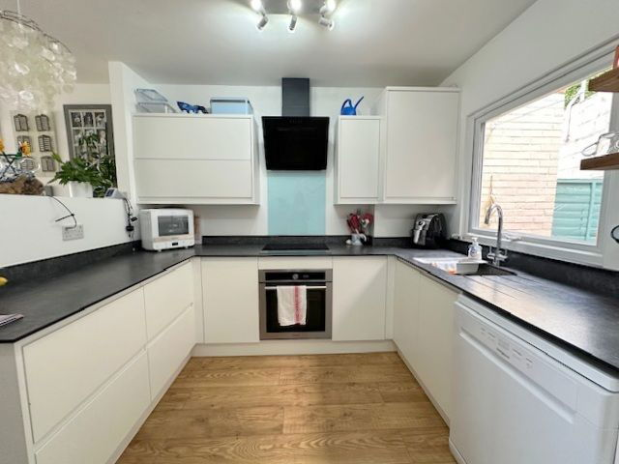
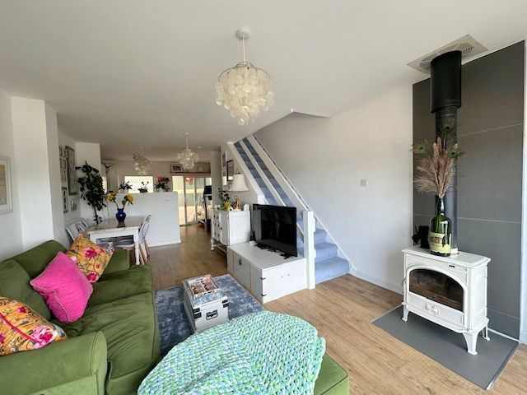
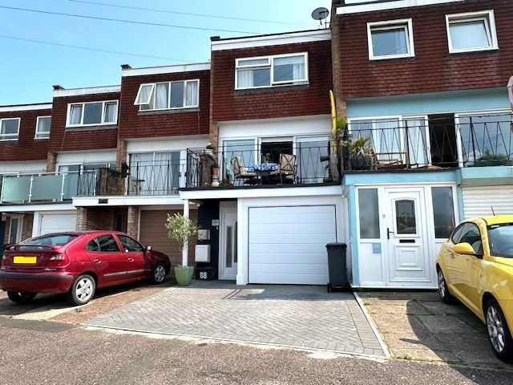
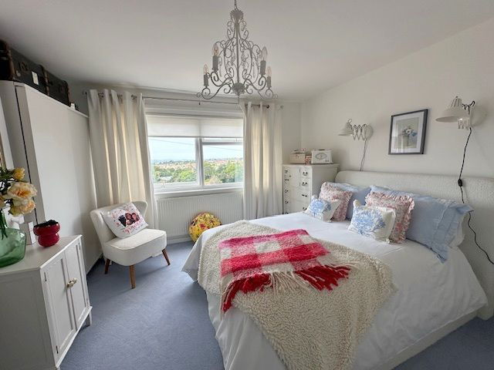
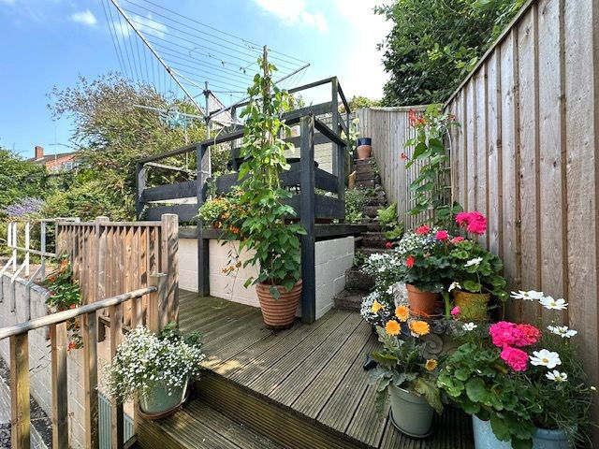
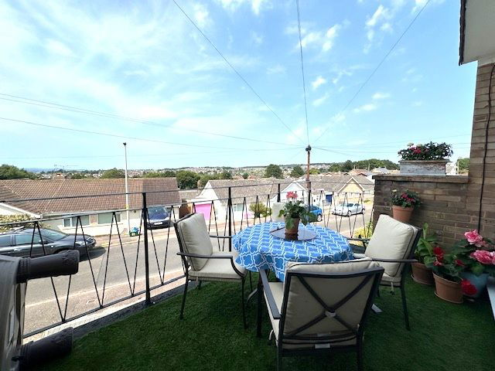
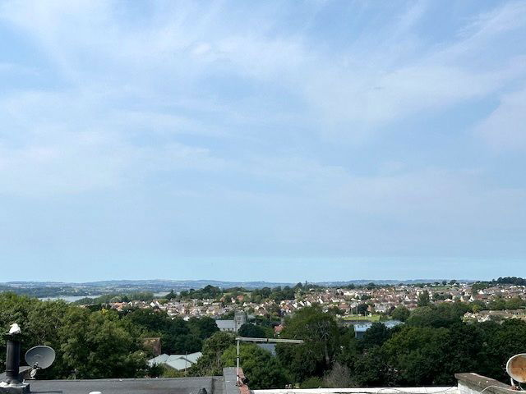
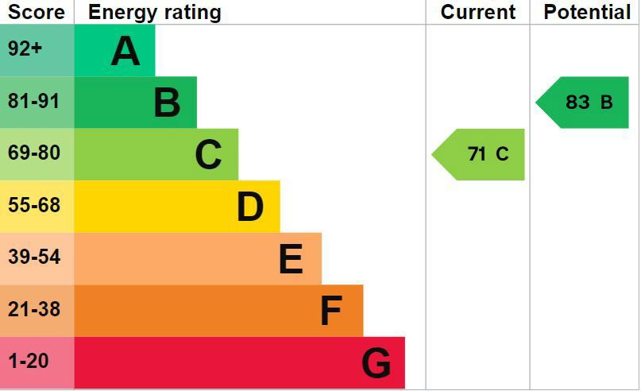
www.pennys.net
88 Ashleigh Road, Exmouth, EX8 2JZ
GUIDE PRICE £325,000
TENURE Freehold
A Beautifully Presented Two Bedroom Terraced Town House Situated In A Favoured Location With Pleasant Open Outlook, Parking And Integral Garage
Reception Hall • Ground Floor Cloakroom/WC & Ground Floor Utility Room •
First Floor Open Plan Kitchen With Sliding Doors Onto Rear Courtyard Area •
Two Second Floor Bedrooms - Both With En-Suite Shower/Bathrooms •
Terraced Garden Over Three Levels To Rear Aspect - Gaining Stunning Open Views •
Gas Central Heating & Double Glazed Windows • Integral Garage •
Viewing Highly Recommended •
Pennys Estate Agents Limited for themselves and for the vendor of this property whose agents they are give notice that:- (1) These particulars do not constitute any part of an offer or a contract. (2) All statements contained in these particulars are made without responsibility on the part of Pennys Estate Agents Limited. (3) None of the statements contained in these particulars are to be relied upon as a statement or representation of fact. (4) Any intending purchaser must satisfy himself/herself by inspection or otherwise as to the correctness of each of the statements contained in these particulars. (5) The vendor does not make or give and neither do Pennys Estate Agents Limited nor any person in their employment has any authority to make or give any representation or warranty whatever in relation to this property.
PENNYS ESTATE AGENTS
2 Rolle House, Rolle Street, Exmouth, Devon, EX8 2SN
Tel: 01395 264111 EMail: help@pennys.net

Slide 2
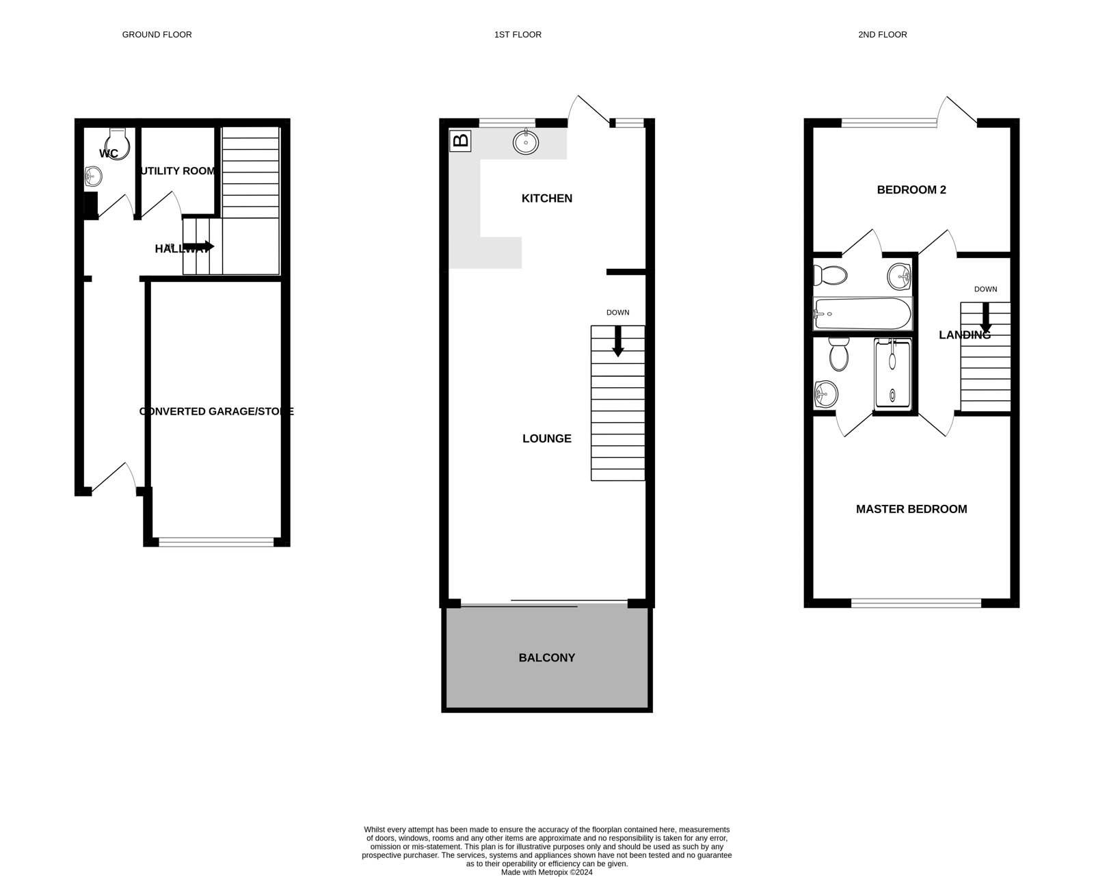
88 Ashleigh Road, Exmouth,EX8 2JZ
THE ACCOMMODATION COMPRISES: Entrance canopy with uPVC front door with patterned glass window inset giving access to: RECEPTION HALL: Wood effect flooring; sensory light; LED ceiling spotlights; radiator with wooden shelf over; smoke alarm; coats rack; cupboard housing electric consumer unit and meter; staircase to FIRST FLOOR LANDING with radiator and thermostat control for gas central heating; door to INTEGRAL GARAGE.
Doors to: CLOAKROOM/WC: Comprising of WC with push button flush; attractive part tiled walls; wash hand basin with chrome mixer tap; radiator; tiled floor. UTILITY ROOM: 1.7m x 1.63m (5'7" x 5'4") Tiled floor; cold water tap; plumbing for automatic washing machine; additional appliance space to side; wooden drying rack; wall mounted cupboard; radiator. FIRST FLOOR OPEN PLAN KITCHEN/LOUNGE/DINING ROOM: KITCHEN AREA: 3.89m x 2.79m (12'9" x 9'2") Fitted with grey slate solid worktop surfaces with matching splashbacks; range of cupboards and drawer units with inset sink unit and integrated drainer with mixer tap; space for dishwasher beneath; built-in electric oven with four ring ceramic hob above and chimney style extractor hood over; wall mounted up and over cupboards; cupboard housing Ideal gas boiler serving domestic hot water and gas central heating; wood flooring; space for upright fridge freezer; uPVC double glazed window overlooking rear garden; telephone point; wooden shelving; uPVC double glazed sliding patio doors opening onto REAR COURTYARD: REAR COURTYARD: Artificial grass; wood panel features; washing line. LOUNGE/DINING AREA: 6.27m x 3.91m (20'7" x 12'10") With wood flooring throughout; smoke alarm; two radiators; television point; shelving over stairwell recess; feature log burner standing on porcelain tiles with matching tiled hearth; wooden shelving with inset lights; stairs to SECOND FLOOR; uPVC double glazed sliding patio doors opening onto: SUN BALCONY: 3.96m x 2.36m (13'0" x 7'9") A stunning feature to the property laid with artificial grass and cast iron railings which enjoys an attractive outlook across the town with estuary and coastline glimpses. SECOND FLOOR LANDING: Doors to: BEDROOM ONE: 3.91m x 3.56m (12'10" x 11'8") A stunning main bedroom with uPVC double glazed windows to front aspect affording stunning open views towards the town centre, estuary and beyond; radiator; attractive wall lights; door to: EN-SUITE SHOWER ROOM/WC: Stylishly fitted with double width shower cubicle with glass door; rainfall shower and detachable shower head hose; attractive part tiled walls and tiled floor; WC with push button flush; wash hand basin with chrome mixer tap and cupboard below; mirror fronted medicine cupboard; chrome heated towel rail; extractor fan.
BEDROOM TWO: 3.91m x 2.72m (12'10" x 8'11") Another good size bedroom with uPVC double glazed window to rear aspect and uPVC double glazed patio doors opening onto OUTSIDE; coved ceiling; radiator; television point; door to:
EN-SUITE BATHROOM/WC: Stylishly fitted with 'P' shaped bath with chrome mixer tap, rainfall shower and detachable shower head hose and glass shower screen door; WC with push button flush; wash hand basin set in vanity unit draws below; mirror fronted medicine cabinet; chrome heated towel rail; extractor fan; spotlights; attractive part tiled walls and tiled floor. OUTSIDE: To the front of the property there is a block paved driveway providing parking for approximately two cars and leading to the GARAGE. To the rear of the property accessed via patio doors (From Bedroom Two) opening onto a hard standing area laid with artificial lawn and further steps with rockery garden leading to three hardstanding areas ideal for outside al-fresco dining with well stocked shrub beds. The garden area also enjoys a pleasant outlook towards the estuary and coastline beyond and is enclosed via timber fencing. INTEGRAL GARAGE: 5m x 2.57m (16'5" x 8'5") Electric roller up and over door; power and light connected; sensor light.
FLOOR PLAN:

